Slide 1
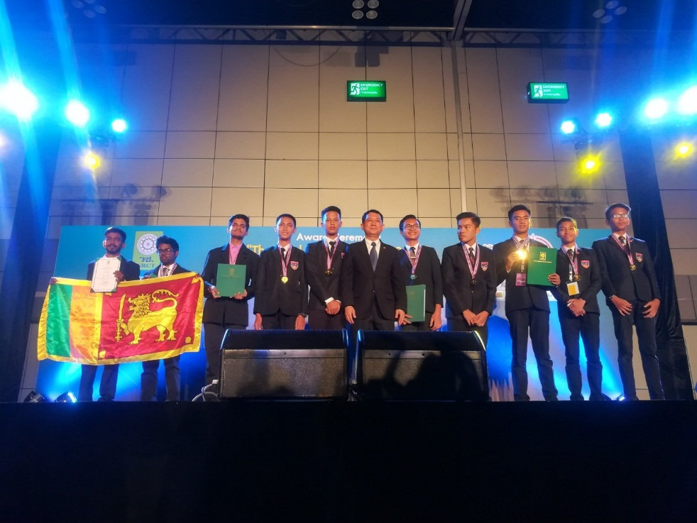
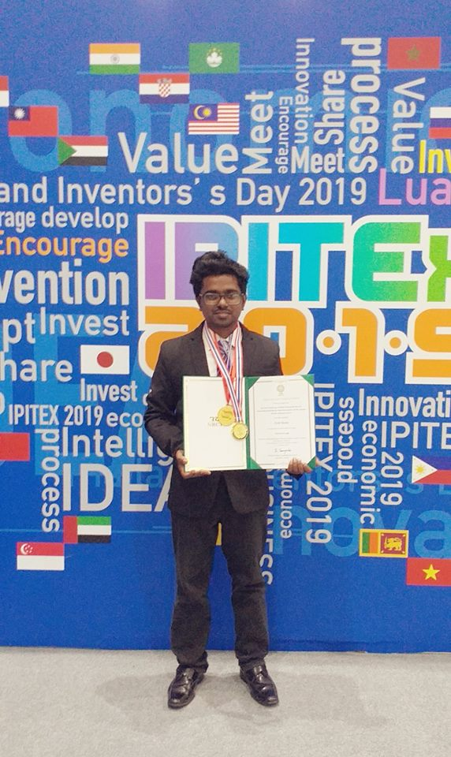
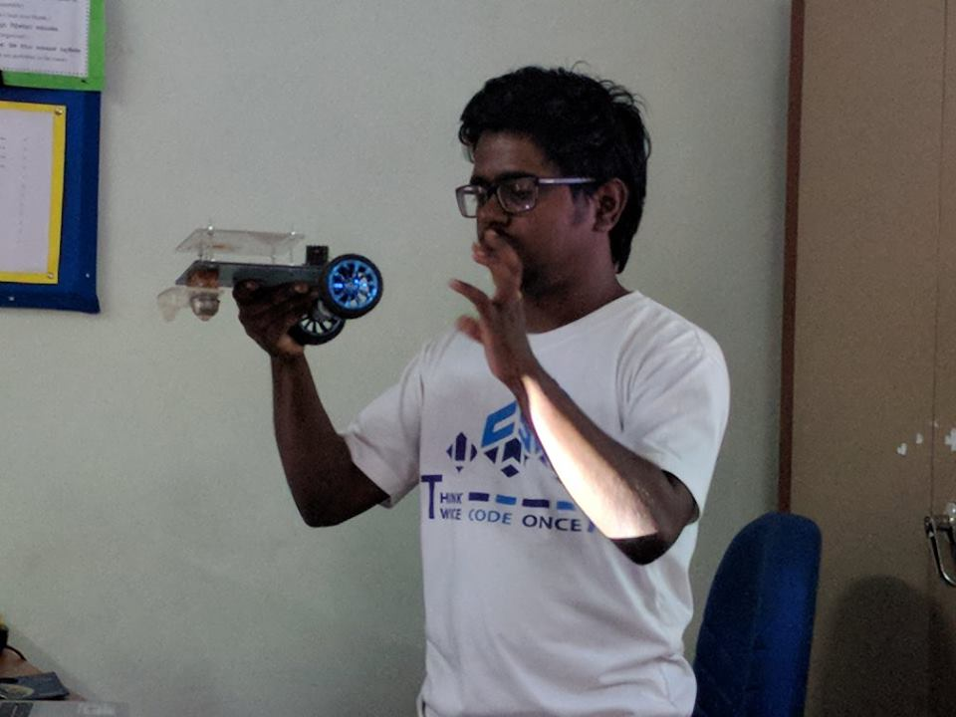
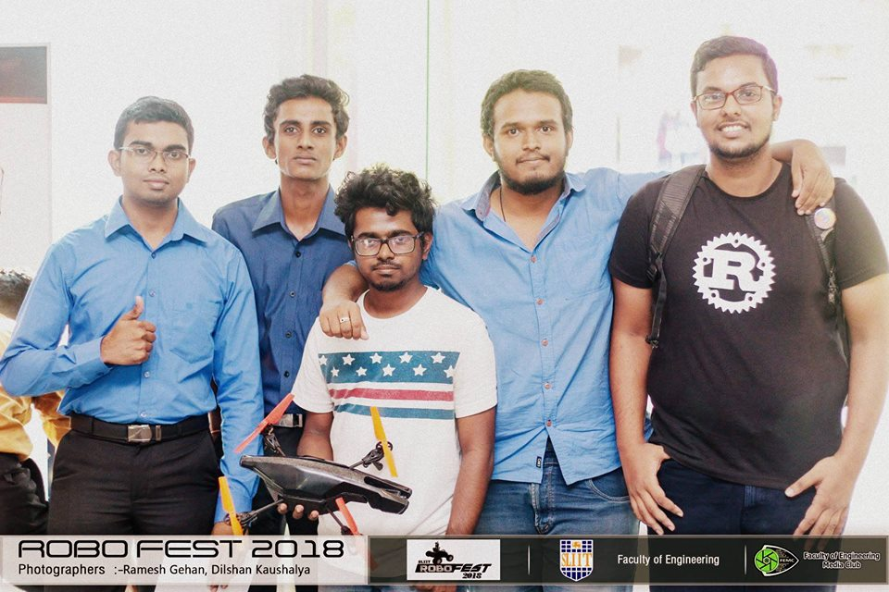
Projects Book
Buddhika P. De Silva
Department of Computer Science and Informatics, Uva Wellassa University

Slide 2
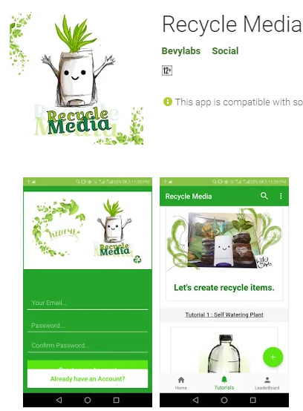
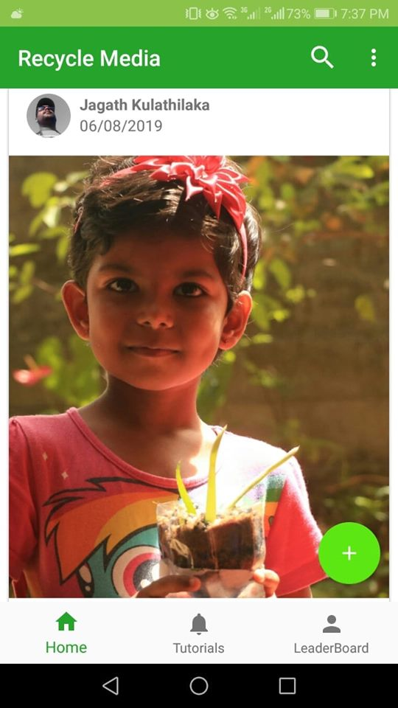

Project Name: Recycle Media App
Used Technologies : Android, Firebase , Digital Arts , HTML, Bootstrap.
Description : Social media platform for sharing creative recycle DIY projects and awareness platform for save earth from plastics.
What I learnt : Dealing with large number of data of people, Security concerns when maintaining a social media, Building a product that makes positive impact to people and the environment , Improve android development skills and digital painting skills , Creating DIY creative items using plastics Project URL :https://play.google.com/store/apps/details?id=in.tvac.bevylabs.photoblog

Slide 3
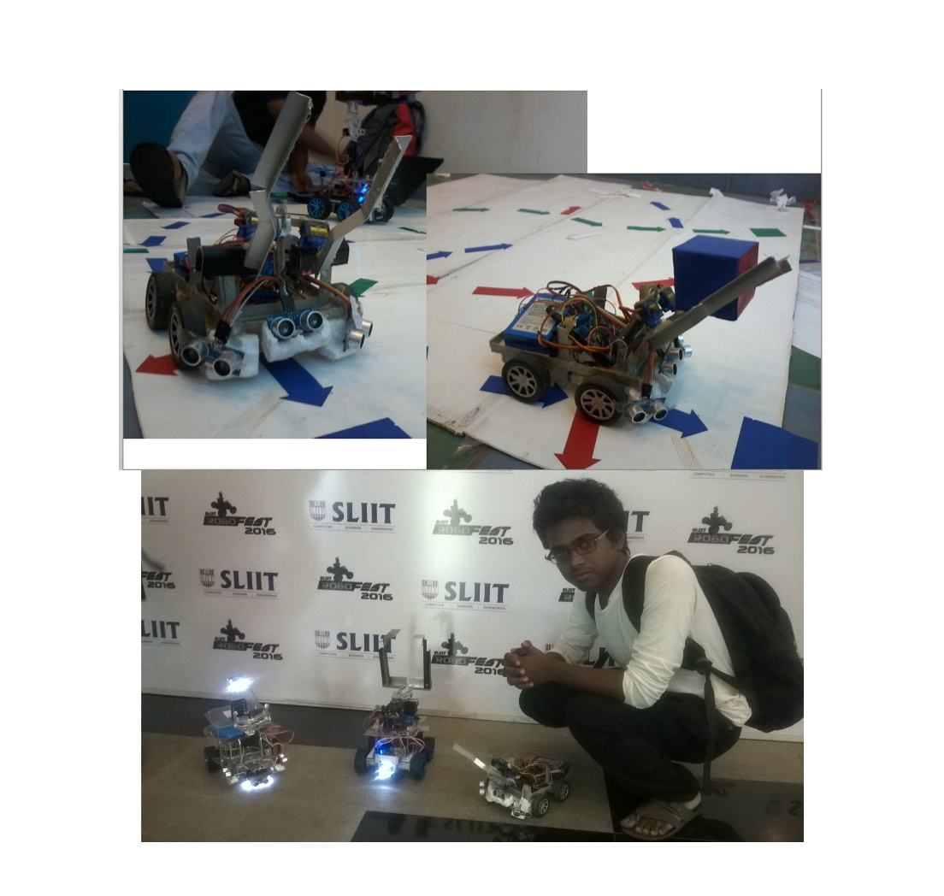
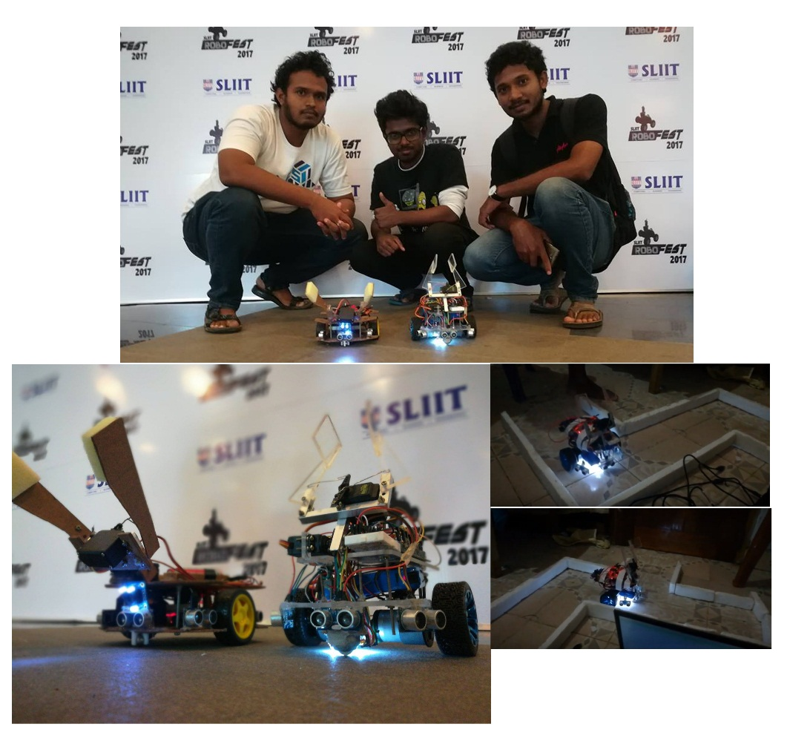
Project Name: Maze-Solving Robot
Used Technologies : Arduino , Sensors ( Color , ultrasonic ) , Maze Solving algorithms
Description : This robot is designed for grab objects with color detection , wall maze solving and going though the limited spaces.
What I learnt : Working with sensors , improved problem solving knowledge , team work , learnt to convert ideas into codes , working with limited time schedules.

Slide 4
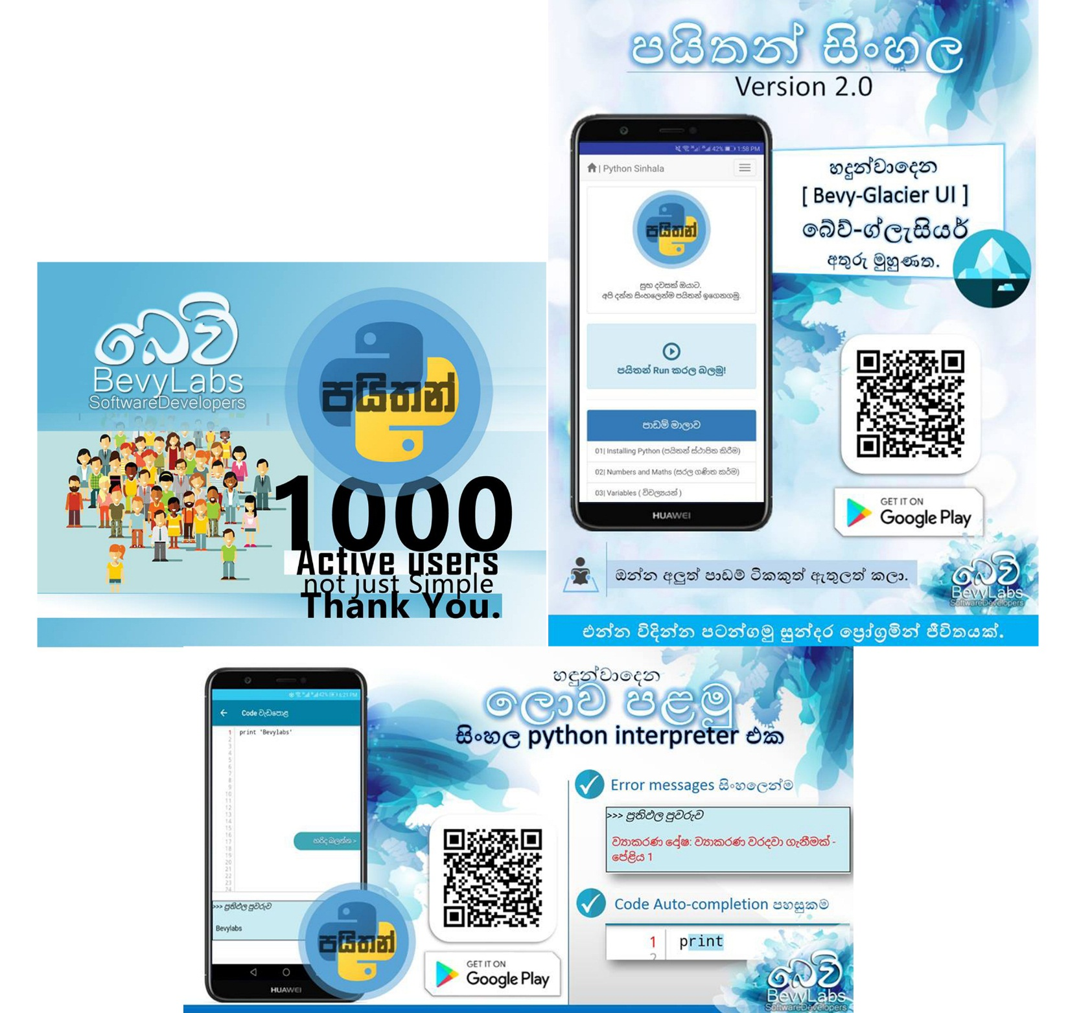
Project Name: Python Sinhala
Used Technologies: Android Studio, Java, HTML , Bootstrap
Description: An android application that helps people to startup with programming. It has over 5000 downloads through the Google Playstore.
Project URL : play.google.com/store/apps/details?id=bevylabs.buddhika.pythonsinhala What I leant : How to improve ideas ( I continuously improved eBook that I wrote in my school time into multifunctional guide to programming students), Marketing a product , UI designing , tutorial planning.

Slide 5
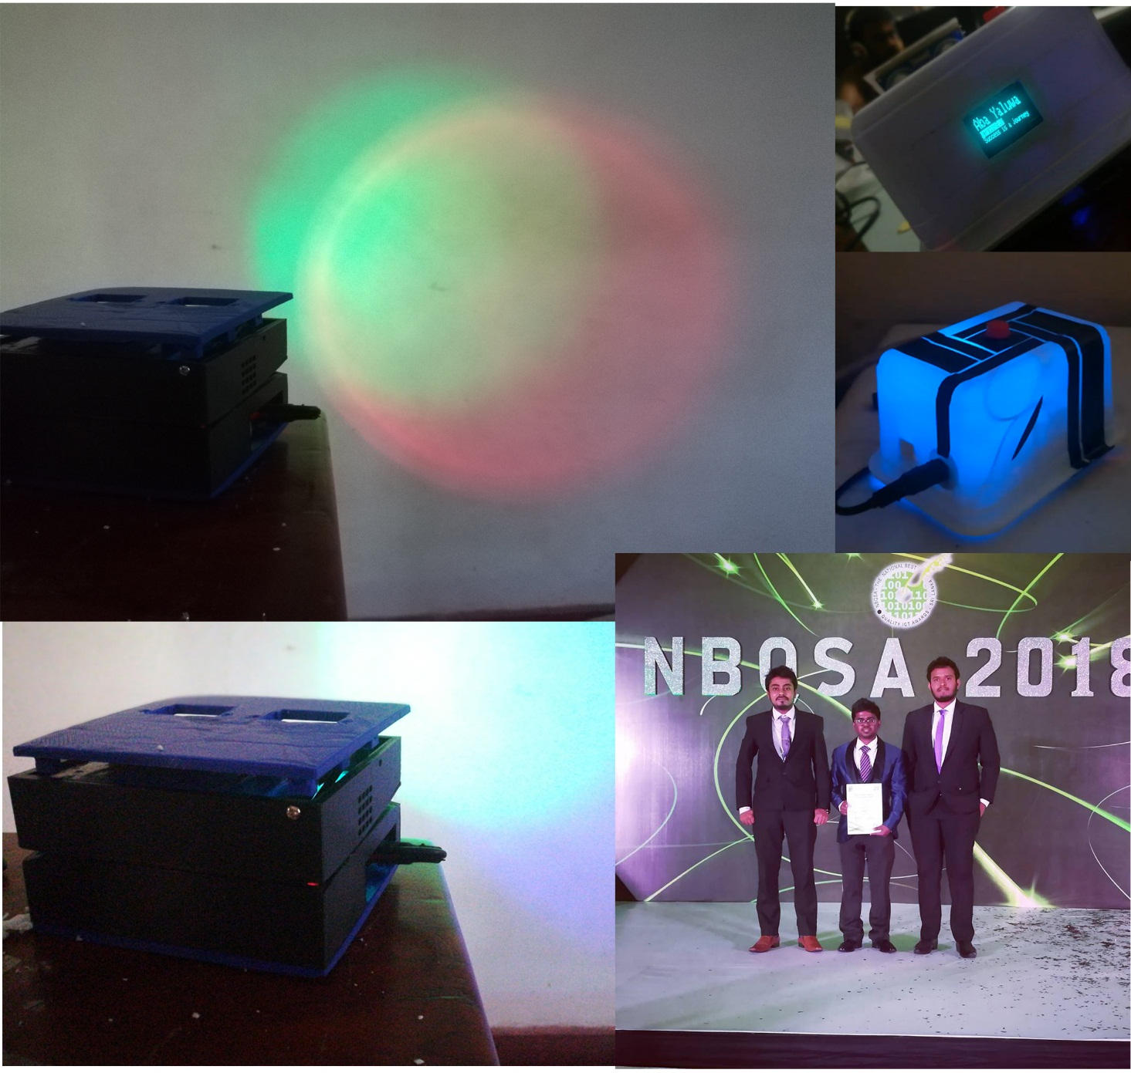
Project Name: “Amba Yaluwa” – The Concentration Device
Used Technologies: Arduino ,NodeMCU, C , Electronics
Description: A concentration device that based on psychology techniques (Color psychology , Pomodoro technique)
Awards : 3rd Place ( Bronze Medal ) in Applied Science & Technology “Sahasak Nimeum” National Exhibition and Competition 2018 An Exhibition Organized by Sri Lanka Inventors Commission.
Merit Award - National Best Quality ICT Awards (NBQSA) 2018 Organized by British Computer Society (BCS) – The Chartered Institute for IT.
Finalist IEEE SS12 MakerFair South Asian Exhibition and Competition 2018 An innovations exhibition Organized by IEEE
What I learnt : Believing the ideas ,psycology techniques, prototyping, improving the version of an hardware project , 3D printing , working with interrupts in micro controllers.

Slide 6
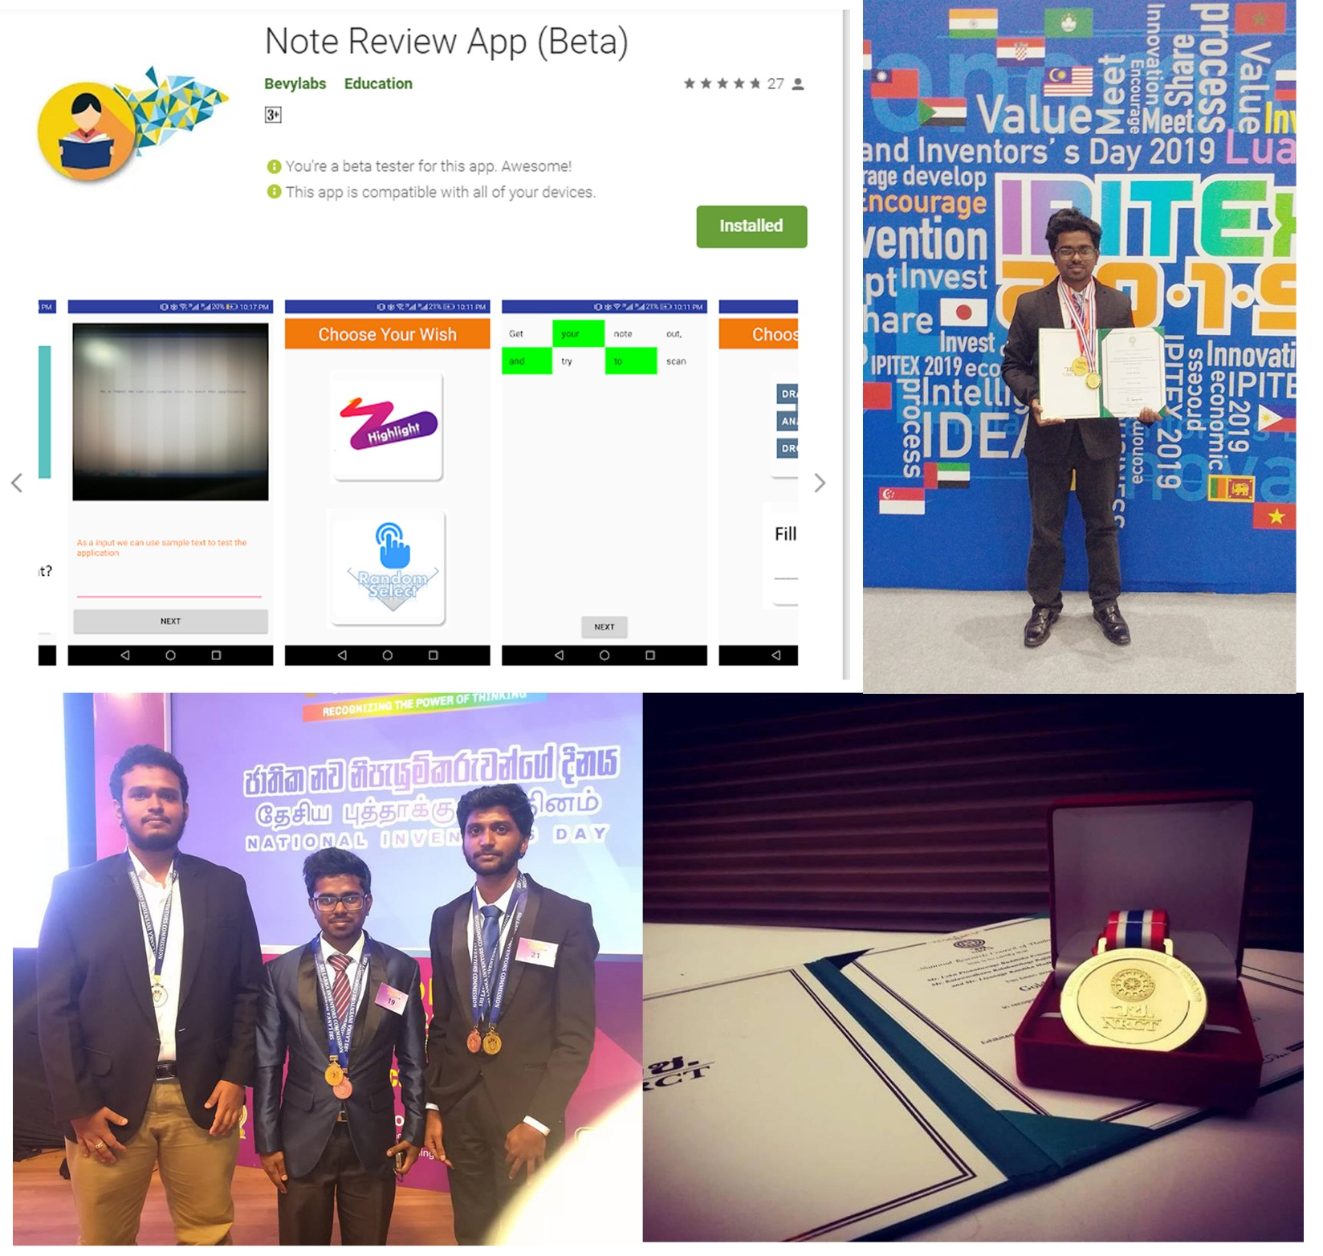
Project Name: NoteReview App
Used Technologies: Android Studio, Java, GoogleVisionAPI
Description: A solution for review notes and can evaluate the user in less than in 2mins.
Awards : Gold Medal - IPITEx 2019 (International Exhibition and Competition ) Bangkok International Intellectual Property Invention, Innovation and Technology Exposition.
1st Place ( Gold Medal ) in ICT Category “Sahasak Nimeum” National Exhibition and Competition 2018 An Exhibition Organized by Sri Lanka Inventors Commission
Project URL : play.google.com/store/apps/details?id=com.bevylabs.buddhika.notereview
What I learnt : Working with a team to achive a goal. Convert ideas in to code. Inspire others , 1st experience with android development / Google vision Api , Improving UI and UX in products , presentation skills , working with highly tied shedules, Gifts are impact for the people very much , Represent in an international competition as a Srilankan .

Slide 7
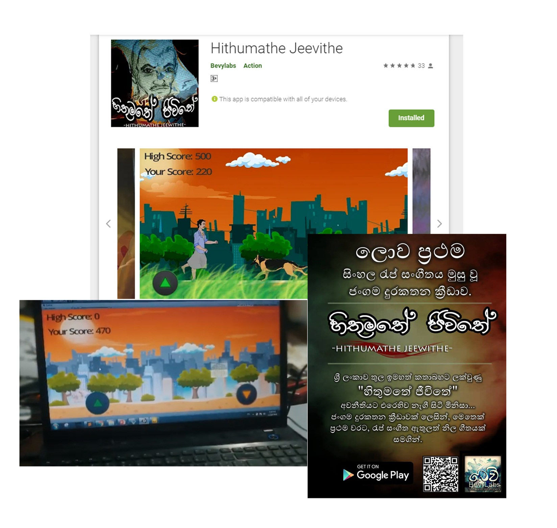
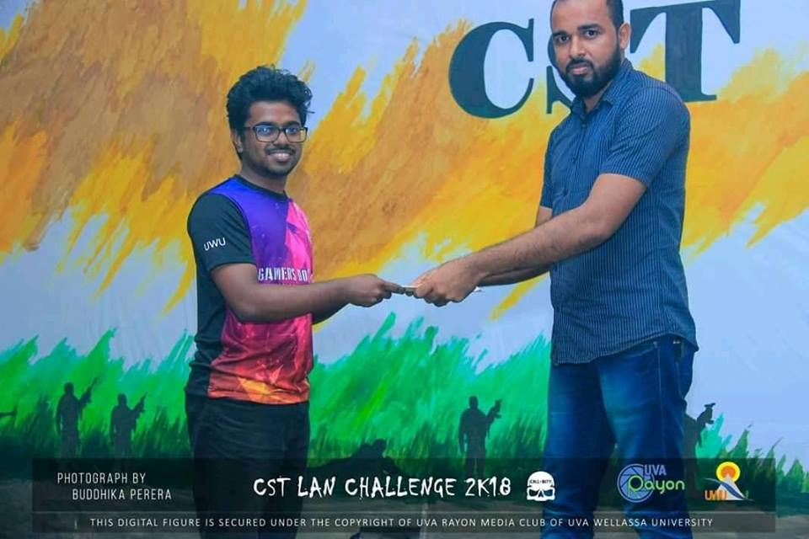
Project Name: Hithumathe Jeevithe – The Android Game
Used Technologies: Unity, Adobe PS, Autodesk SB, FL-Studio.
Description: Sri Lanka’s first game with a rap music. A platformer action game.
Project URL :play.google.com/store/apps/details?id=com.BevyLabs.Hethumathe
Awards : 1 st place UWU GameJam 2018 , A Game Hackathon Organized by Mozilla Campus Club - UWU.
What I learnt : To inspire others and get their skills on the stage , woking with Unity engine , creative thinking, drawing , connecting the people.

Slide 8
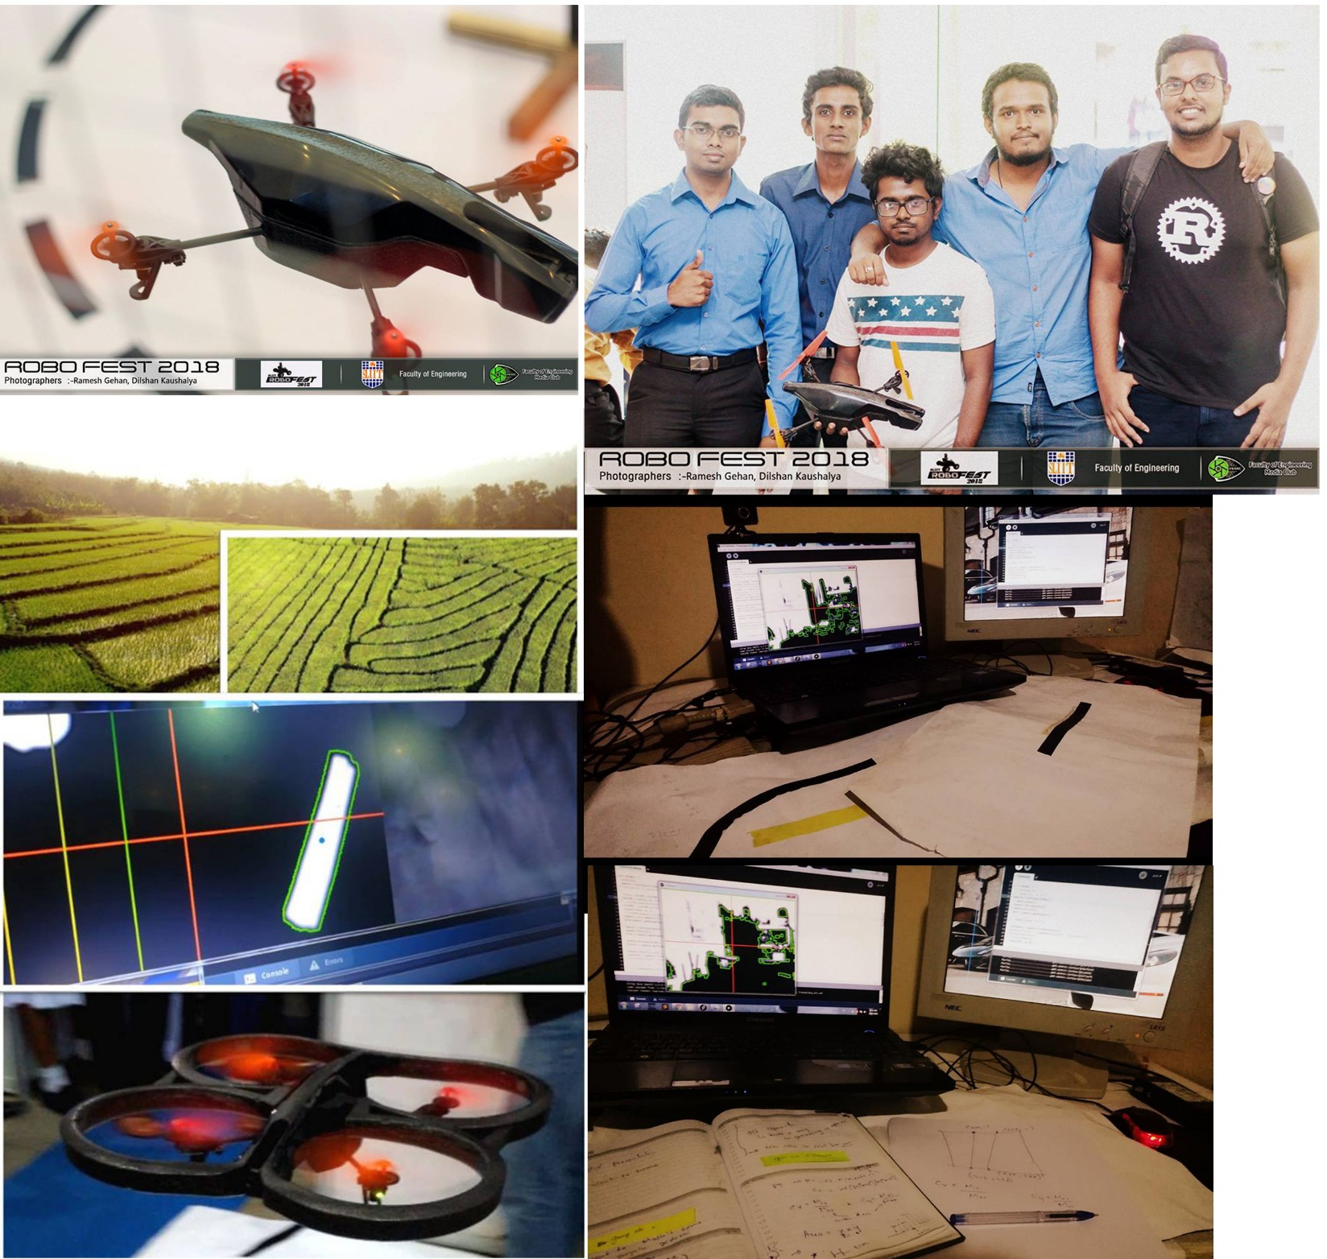
Project Name: “BevyLabsFlyBee”
Used Technologies: Linux kernel, Python, OpenCV, Processing
Description: An autonomous drone that can fly using detecting lines.
What I learnt : Improved dedicated mindset for achive goals. Feels like as an scientist when planning the algorithems / doing calculations on papers / convert ideas into codes, improved team working skills , Had fun with the drone and got some risks when it fly , improved demonstration skills when it explanning in exhibitions.

Slide 9
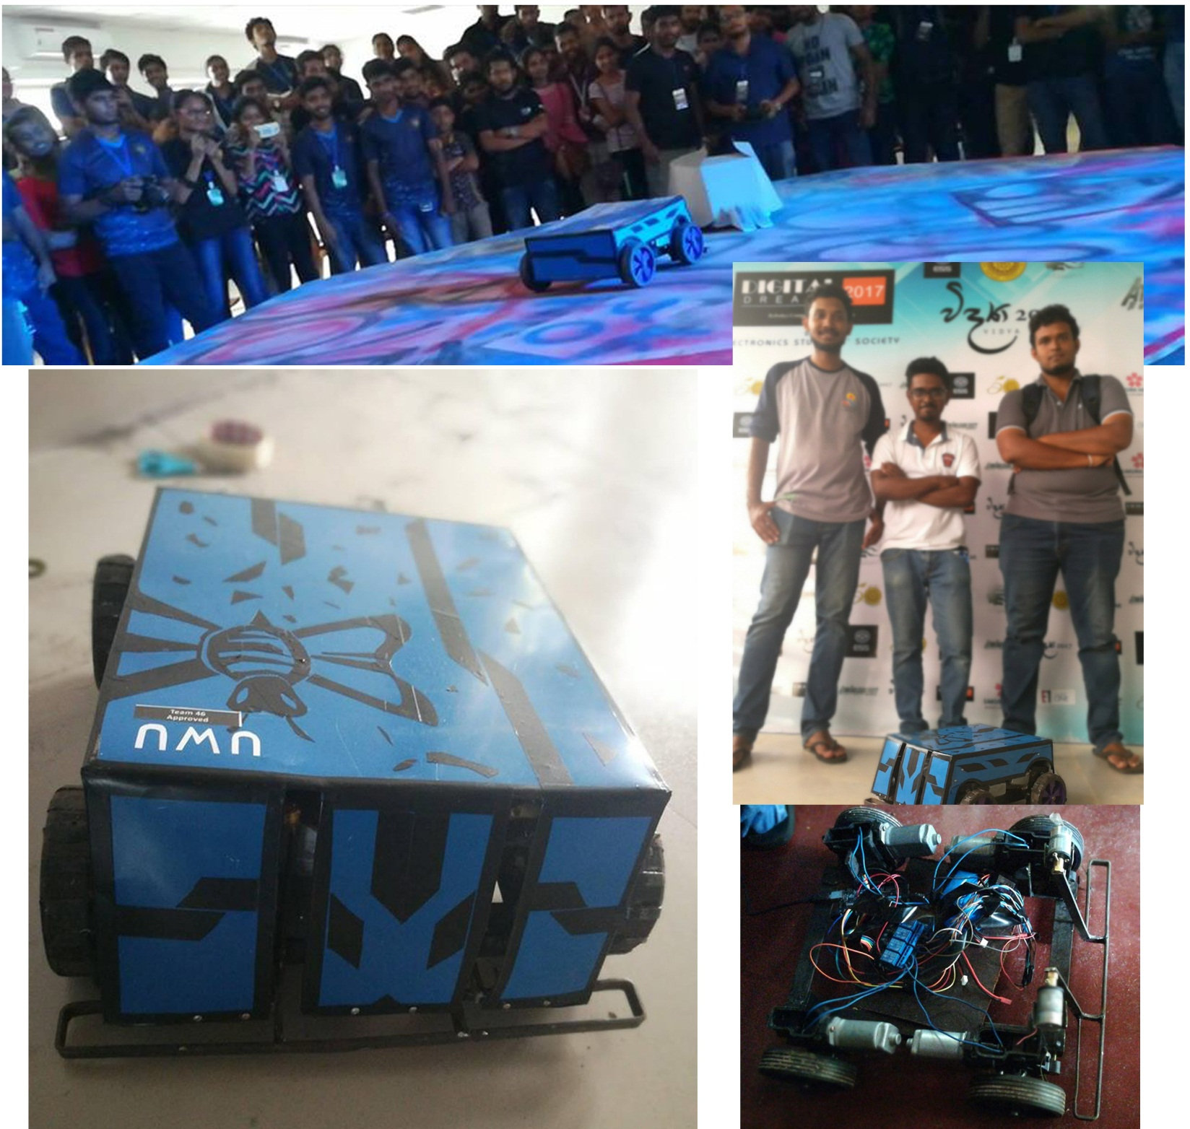
Project Name: BeeBattleBot
Used Technologies : Arduino , heavy motor controlling , working with romote controllers
Description : Battle robot that can push heavy weight and damge opponents.
What I learnt :Experince with heavy motors , improved critical thinking , team work skills , Creative designing.

Slide 10
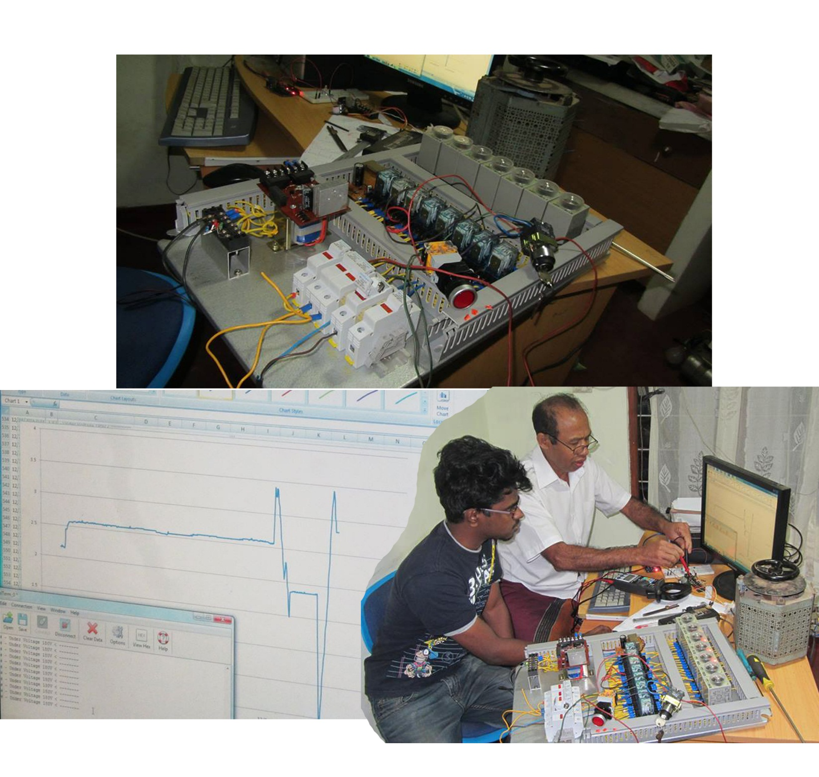
Project Name: Project “GenACMS”
Used Technologies: Arduino, C, Electronics, MSExcel.
Description: A solution for measuring/indicating A/C voltages levels with real-time monitoring system.
What I learnt : Worked with a professional , learnt about industrial equpments, Data visulazing , how to solve real world problems using programming,

Slide 11
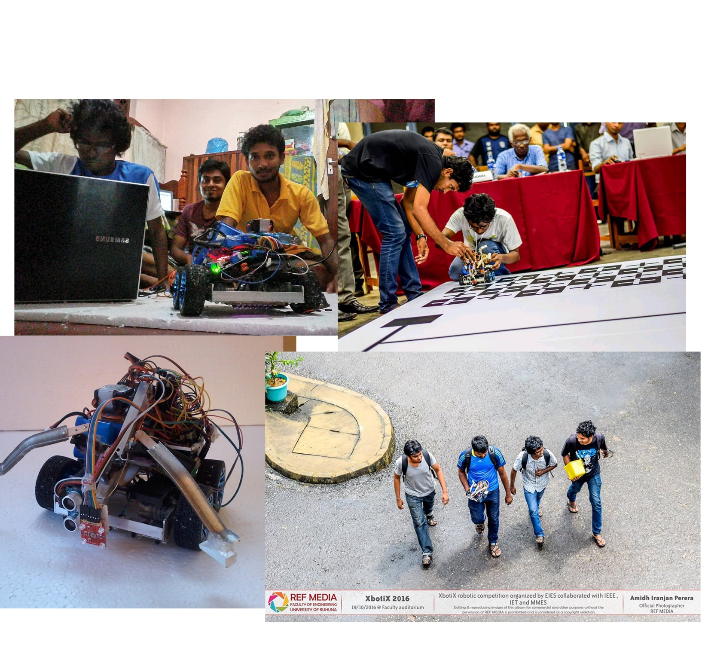
Project Name: Robot SilverTips
Used Technologies : Arduino , Sensors ( Color , ultersonic , IR)
Description : This robot is designed for grab objects with color detectiong , line maze solving and going though the limited spaces.
What I learnt : Working with sensors , improved problem solving knowledge , team work , learnt to convert ideas into codes , working with limited time shedules.
Awards : 5th place of Xboticx 2016 A task based Robotics Competition organized by Faculty of Engineering, University of Ruhuna.

Slide 12
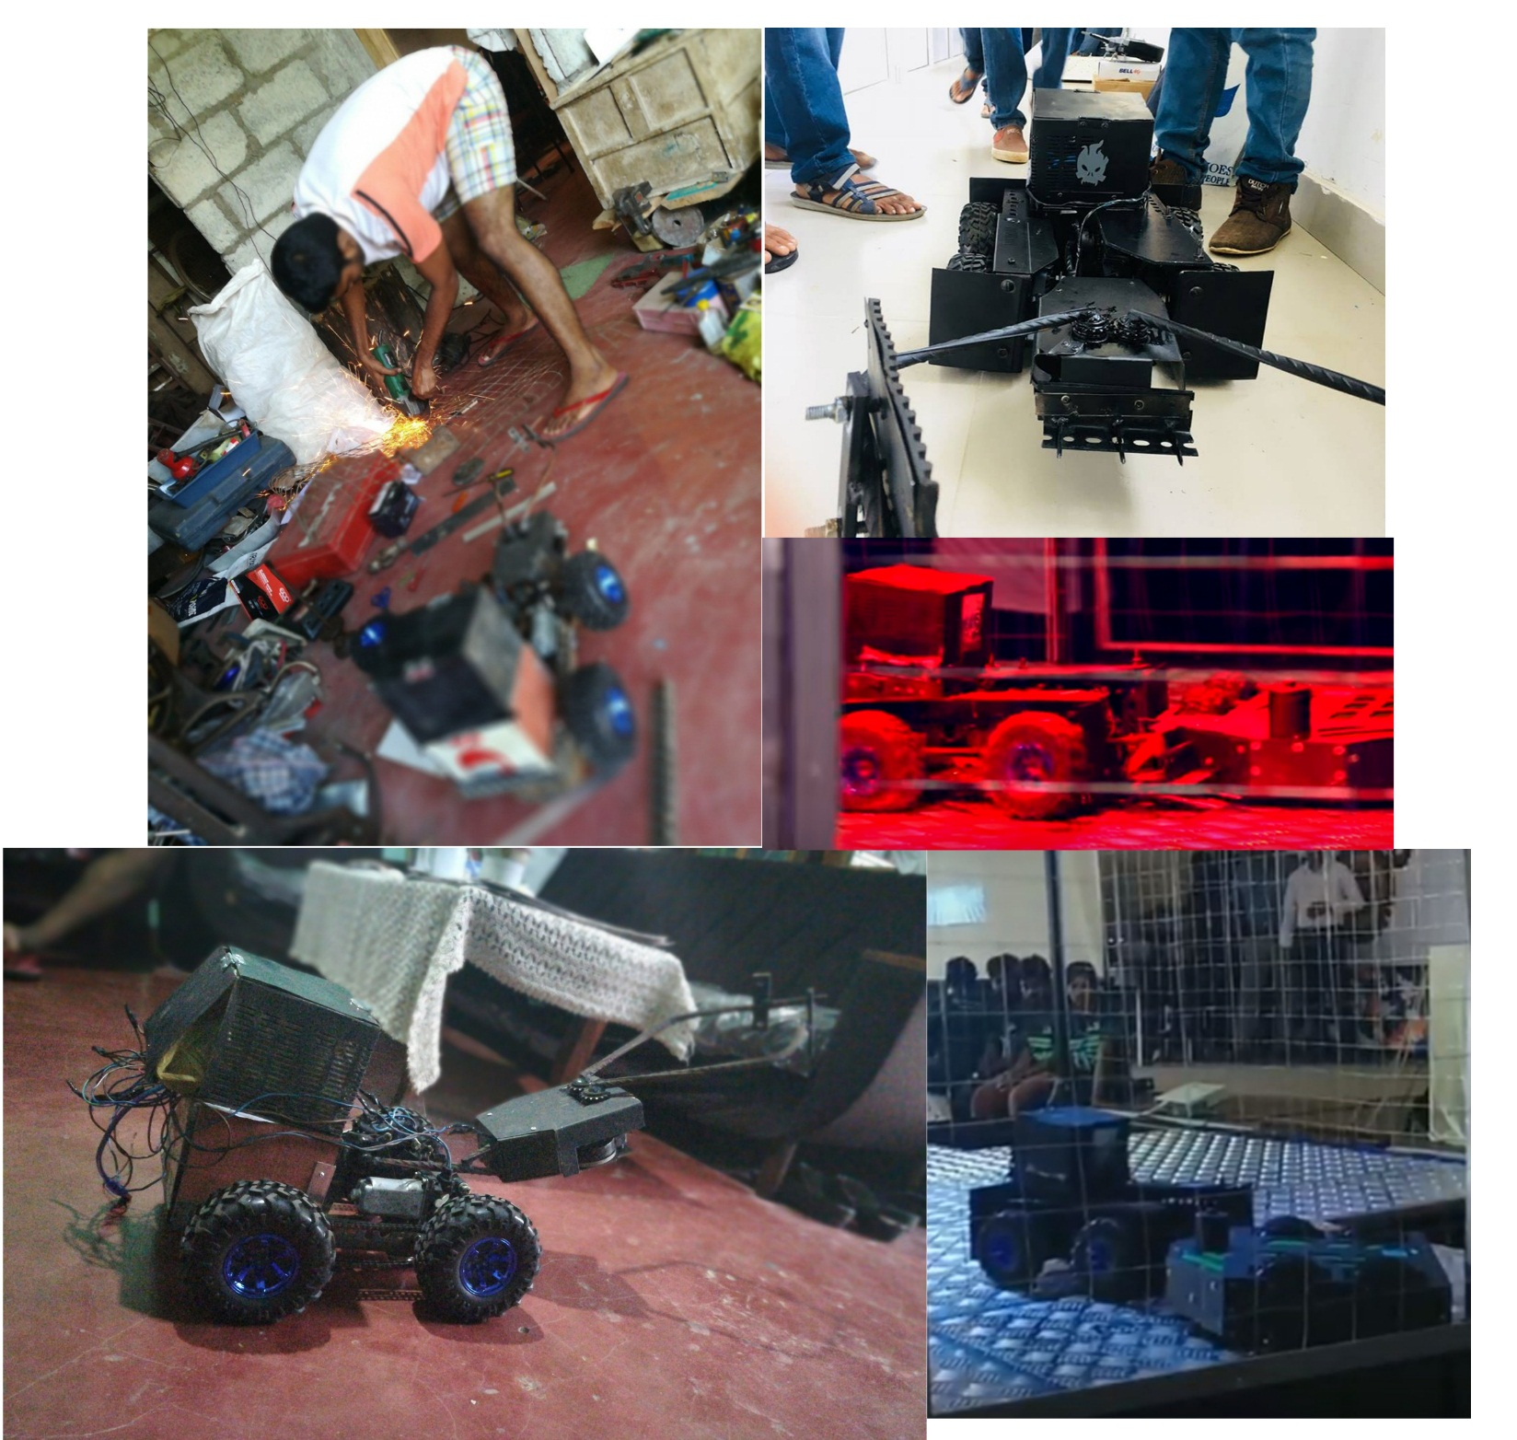
Project Name: Blacky
Used Technologies : Arduino , heavy motor controlling , working with romote controllers
Description : Battle robot that can push heavy weight and damge opponents.
What I learnt :Experince with heavy motors , improved critical thinking , team work skills.

Slide 13
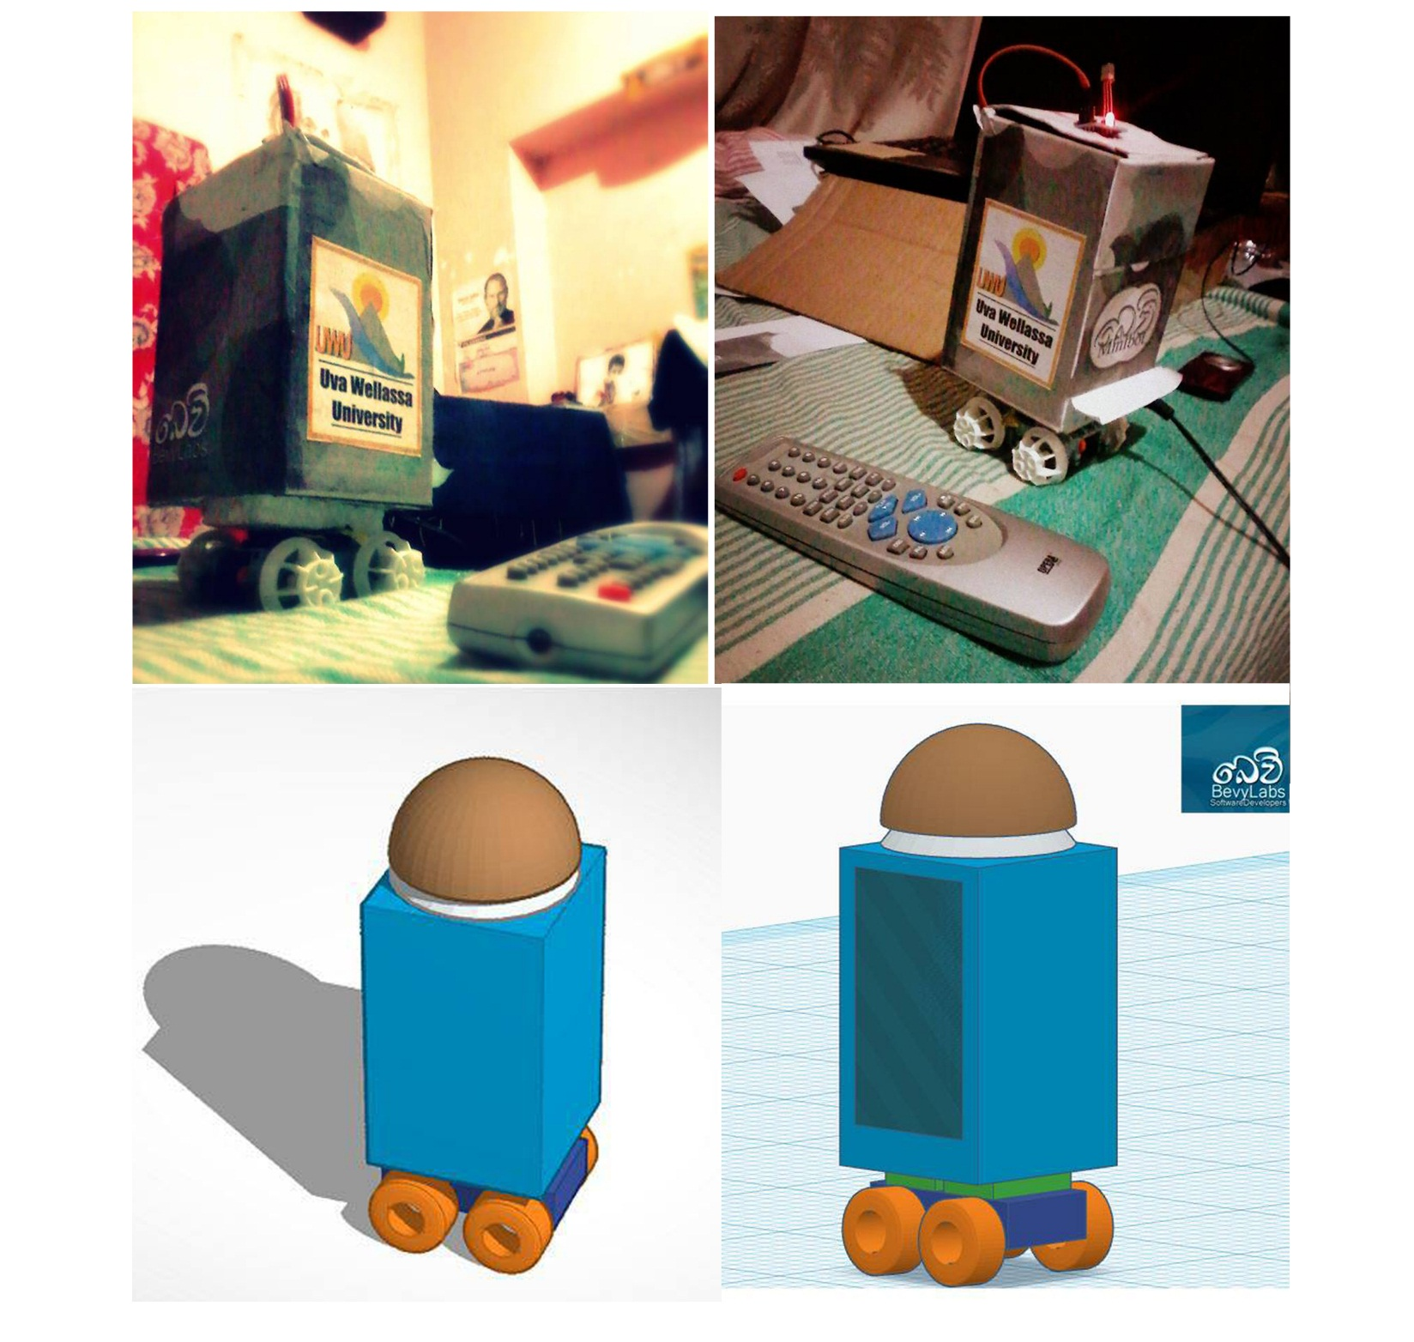
Project Name: BevyMINIbot
Used Technologies : Arduino , heavy motor controlling , working with romote controllers
Description : BevyMINIbot is a concept for a family friendly robot. He has many abilities like Holding small weight like transporting cup of tea, control with your TV remote. We are developing it as a low cost product.
What I learnt : As my first robotics project I really inspired, CAD Desinging , prototyping , working with motor controlling , signal pass using IR sensors.

Slide 14
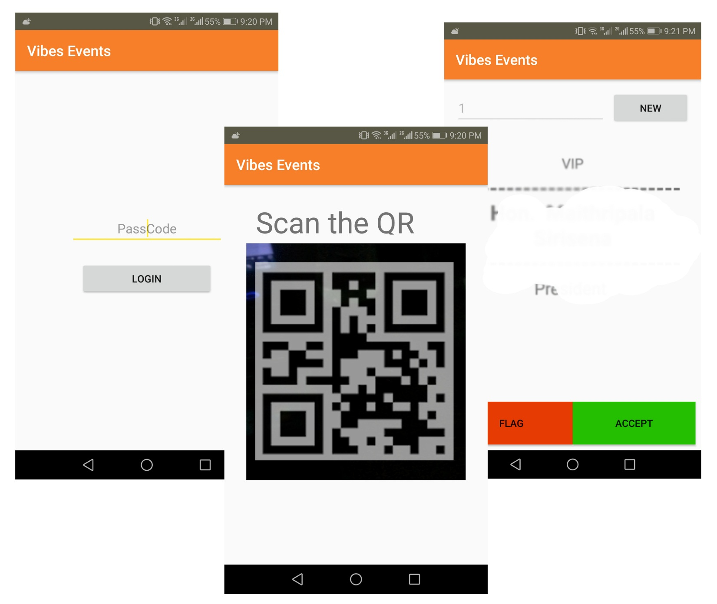
Project Name: Project “Vibes”
Used Technologies : Android, Firebase, GoogleVisionAPI, MSExcel
Description : A mobile solution for who want to mark attendance of a large number of people in less amount of time. Successfully implemented for a VIP event in Srilanka.
What I learnt : How I work with a highly risky project , working with realtime database like firebase, Manage time with the busy time schedule , Data pass between more than one different databases , Build more responsive application , improve the UX / UI with feedbacks

Slide 15
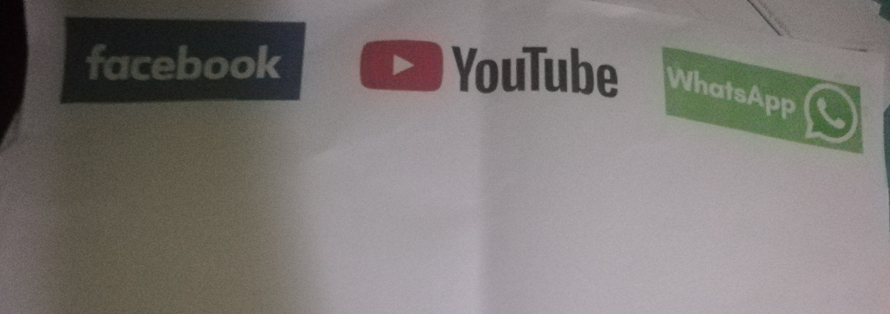
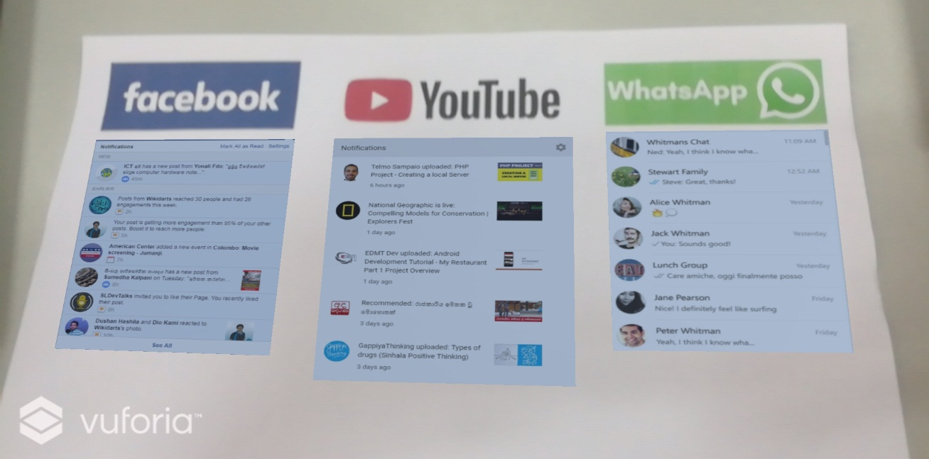
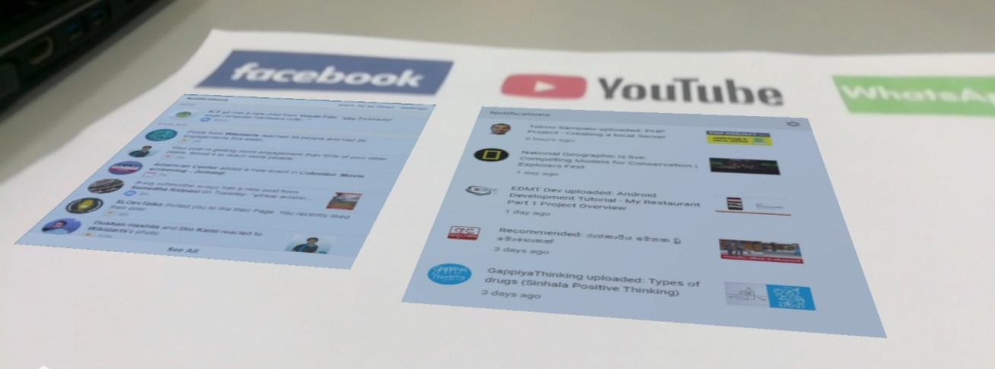
Project Name: Social Noti.
Used Technologies : Unity, Vuforia , Augmented Reality.
Description : This application can check and display social media notifications in one place with augmented Reality. As the markers I used social media icons , if camera point out to it , below that notification are appear. What I learnt : Think in different way to use AR for solve real world problems , Learnt more about Unity and Vuforia.

